Slide 1
British Airways
Scrape and analyze customer review data to uncover findings for British Airways

Slide 2
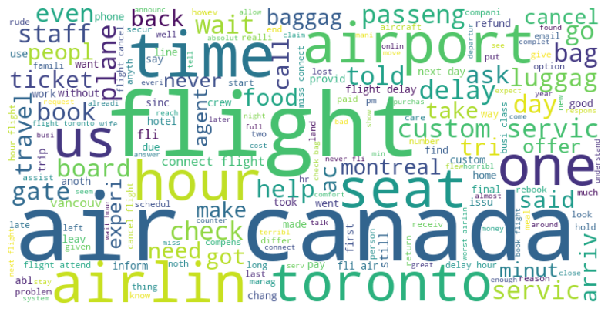
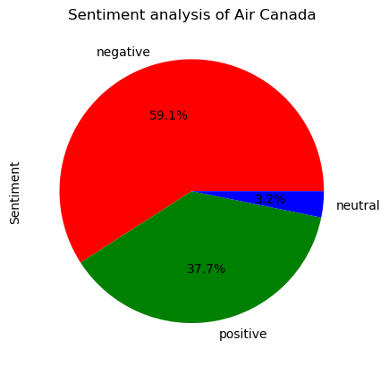
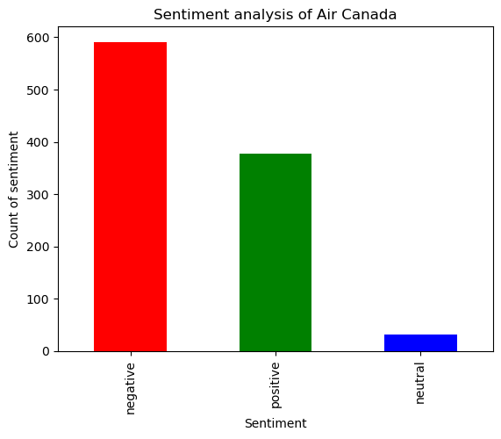
Analysis Of The Reviews

